Slide 1

Introduction to GitHub
Accessing, Sharing, and Storing Your Code and Notebooks
Wally Novak, Pauk Craig, Chris Berndsen, Mike Foster
CodeBMB Workshop – BCCE 2026

Slide 2
By the End of This Session You Will Be Able To...
Explain what GitHub is and why it is useful for scientists
Navigate a GitHub repository to find files and notebooks
Open a Colab notebook directly from GitHub
with or without an Open in Colab button
Fork a repository to create your own editable copy
Save a notebook back to GitHub

Slide 3
What Is GitHub and Why Do We Use It?
Think of GitHub as a combination of three things:
📁 Shared drive
📓 Lab notebook
🔗 Publishing platform
Store and access files from anywhere, on any device
Every change is recorded with who made it and when
Share your code with colleagues, students, or the world
Why GitHub specifically?
Free for public repositories
Used across science, industry, and education worldwide
Integrates directly with Google Colab with the Open in Colab button
Easily update materials (version control)

Slide 4
Key GitHub Vocabulary
Five terms you need to know before we start:
Repository (repo)
A folder that contains all the files for a project — code, notebooks, data, and documentation. This is effectively a project folder that lives in the cloud.
README
A text file (usually README.md) that appears on the front page of a repository. It explains what the project is and how to use it.
Commit
A saved snapshot of your files at a specific point in time, with a short message describing what changed.
Fork
Your own personal copy of someone else's repository. You can make changes to your fork without affecting the original.
Branch
A parallel version of the repository, the one you want is almost always called 'main.' You will rarely need to think about branches as a beginner.

Slide 5
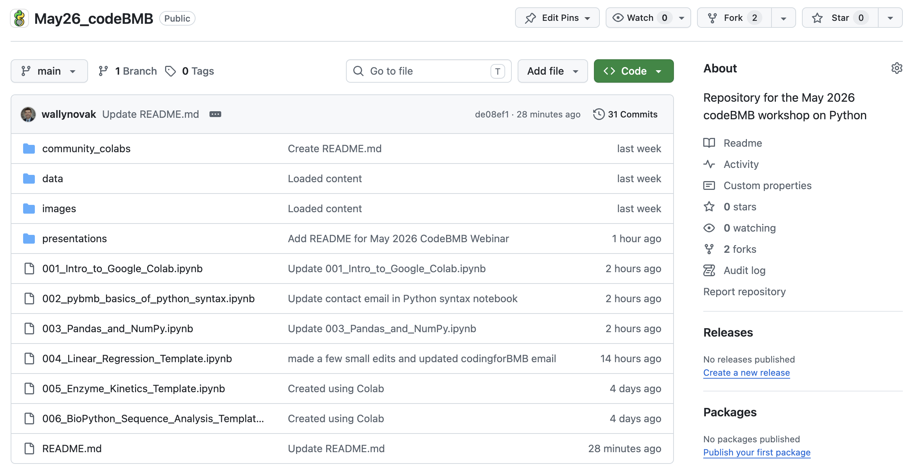
Anatomy of a GitHub Repository
① Repository name
② Folders
③ Notebooks
④ README

Slide 6
Walkthrough 1 — Finding the CodeBMB Repository
▶ WALKTHROUGH
Step 1
Open a browser and go to: github.com
Step 2
In the search bar at the top, type: codeBMB and press Enter
Step 3
Click on the repository: codeBMB/July26_BCCE
Step 4
Read the README, this tells you what the repository contains
Step 5
Click on the file 001_Colab_and_Python_essentials.ipynb to see what a notebook looks like on GitHub
💡 Tip: You do not need a GitHub account to browse, read, or download files.

Slide 7

Walkthrough 2 — Forking a Repository
▶ WALKTHROUGH
A fork is your own personal copy of the CodeBMB repository. You can edit it, save to it, and build on it, all without changing the original!
1
Go to github.com/codeBMB/July26_BCCE
2
Click the Fork button in the top-right corner of the repository page
3
Leave all settings as default and click Create fork
4
GitHub redirects you to YOUR copy of the repository at: github.com/YOUR-USERNAME/July26_BCCE

Slide 8
Walkthrough 3 — Opening a Notebook in Colab
▶ WALKTHROUGH
Use the GitHub tab in Colab
1
In your web browser, go to colab.research.google.com
2
Click File → Open notebook
3
Click the GitHub tab
4
Enter the repository: YOUR-USERNAME/July26_BCCE
5
Select the notebook you want, and it opens immediately
6
Let’s open notebook 001_Colab_and_Python_Essentials.ipynb

Slide 9
Walkthrough 4 — Saving a New Colab Notebook
▶ WALKTHROUGH
1
Go to File → Save a copy in GitHub
2
The first time you do this, GitHub may ask you to authorize Colab — click Authorize and sign in
3
In the dialog box that appears, select your repository from the dropdown
4
Confirm the branch is set to main and add a short commit message describing what you saved (e.g., "Add intro notebook")
5
Ensure Include a link to Colab is checked and click OK — your notebook is now saved to GitHub with an open in GitHub link that anyone can use!
You can run the rest of the workshop notebooks from your forked copy!
You ROCK!

Slide 10

This is enough GitHub to get started!
Let’s learn some Colab and Python ☺

Slide 11
Walkthrough 5 — Creating a New Repository
▶ WALKTHROUGH
You can create a new repository for your own ideas. You can edit it, save to it, and build on it.
1
Go to github.com/YOUR-USERNAME
2
Click the + icon in the top-right corner of the page
3
Select New repository from the dropdown menu
4
Fill in the Repository name — use something descriptive like my-chemistry-notebooks or Red40-assay
5
Set visibility — choose Public so anyone can access your notebooks via the Open in Colab badge
6
Check Add a README file — this creates the front page of your repository automatically, then click Create repository

Slide 12
Walkthrough 4 (Again) — Saving a New Colab Notebook
▶ WALKTHROUGH
Repeat Walkthrough 4 to save your notebook in your new repository!
1
Go to File → Save a copy in GitHub
2
The first time you do this, GitHub may ask you to authorize Colab — click Authorize and sign in
3
In the dialog box that appears, select your repository from the dropdown
4
Confirm the branch is set to main and add a short commit message describing what you saved (e.g., "Add intro notebook")
5
Ensure Include a link to Colab is checked and click OK — your notebook is now saved to GitHub with an open in GitHub link that anyone can use!
N.B. Don’t use the Open in Colab button the first time you open a forked notebook. It still points to the original repo. Instead, use the method in walkthrough 1 to open your notebook and then save it to GitHub with the “Include a link to Colab” button checked. This updates the button to your repository!

Slide 13
Saving Your Work — Three Options
After working in a Colab notebook, you have three ways to save your work:
Option 1
Option 2
Option 3
Save to Google Drive
Save to GitHub
Download the file
File → Save a copy in Drive
File → Save a copy in GitHub
File → Download →
Download .ipynb
No GitHub account needed Saves to your Colab Notebooks folder Best for personal work and quick saves
GitHub account required Saves directly to your forked repository Creates a commit with a message Best for sharing and version control
No account needed Saves a local copy to your computer Can be re-uploaded to Colab later Best as a backup
✅ Best for working on notebooks not ready to share
✅ Best for sharing with students
✅ Best as a backup

Slide 14
GitHub as a Scientific Tool
GitHub is not just for software engineers — it is increasingly the standard for open science:
📓
Every change is recorded with who made it and when. Full history of your analysis — reviewers and collaborators can see exactly what you did and when.
🔗
Post a repository for a course — students fork it, work in their own copy, and submit via GitHub or Google Drive. No emailing notebooks back and forth.
Lab notebook for code
Sharing with students
🌍
Publish your analysis code alongside your paper. Readers can reproduce your results exactly. Journals increasingly require this.
🤝
The PyBMB community shares notebooks on GitHub. Fork a notebook, improve it, and share it back. Living documents that stay current.
Open science
Community and collaboration

Slide 15
Do You Need a GitHub Account?
You, yes! Students? Not necessarily.
❌ No account needed
✅ Account needed
✅ Browse any public repository
🔑 Fork a repository
✅ Read and view files
🔑 Save work back to GitHub
✅ Open a notebook in Colab via badge
🔑 Create your own repository
✅ Open a notebook via the GitHub tab
🔑 Share your notebooks publicly
✅ Download individual files
🔑 Contribute to the CodeBMB community

Slide 16
What You Can Do Now
✅ Navigate any public GitHub repository
✅ Open any notebook in Colab — with or without an Open in Colab button
✅ Fork the July26_BCCE repository
✅ Create your own repository and save a new Colab notebook to it
✅ Save your work back to GitHub (or to Google Drive)
Workshop repository: github.com/codeBMB/July26_BCCE

